Slide 1
ITSM – Session 8
Dr. Phalachandra HL
Acknowledgements:
Significant portions of the information in the slide sets presented through the course in the class are extracted from IT Systems Management -Rich Schiesser and other books/Internet. Since these were intended for presentation in the class room for teaching, instructor resources has been requested from the publisher, but not received yet. I would like to sincerely thank, acknowledge and reiterate that the credit/rights remain with the original authors/publishers only

Slide 2
IT Systems Management
Recap
IT Infrastructure Systems Management involves managing the IT Services running on the IT infrastructure environment components like the Servers, Disk Storage, DBs, Networks and Desktop environments, and providing a stable and responsive IT environment, which supports or furthers the Business of the organization, while being Available, Responsive, Cost efficient, Secure, Scalable,…
We discussed on the support needed from executives, organization structure and positioning of the groups which provide these management services, given that one of the KSF are people, we discussed on approaches for staffing and retaining people with required skills and skill levels, the personal and business ethics or lack of it and it’s impact in-terms of legislation and what that drives into organizations
We also looked at how to evolve the services to a customer centric approach and leveraging the best practices using frameworks like ITIL
Then as part of the 12 Key processes which would discuss as part of the course, we discussed on the processes for managing Availability, Performance –Tuning, Production Acceptance process, Change Management and Problem Management, Storage Management, Network Management, Configuration Management and Capacity Management

Slide 3
IT Systems Management
Recap - 1
As we discussed, the Configuration Management process was focussed on accurately documenting the interrelationships of varying versions of infrastructure hardware and software. We then contrasted the same with versioning and device configuration. We then looked at the different steps which could be followed for configuration management process from selecting an owner and effectively using a technical writer. We also discussed on evaluating the current documentation, involving H/W and S/W vendors and keeping configuration management as part of the upgrade processes.
We also discussed the Capacity Planning as a process which would scientifically predict when, how much, and what type of additional resources would be needed, to support accurately forecasted workloads of Services
We looked at the challenges towards that and steps which could be followed for effectively planning for capacity, considered the benefits of capacity planning process, common costs overlooked while doing capacity planning and also looked at how the Capacity planning process could be assessed and streamlined

Slide 4
Strategic Security Process
BITS Pilani, Deemed to be University under Section 3 of UGC Act, 1956

Slide 5
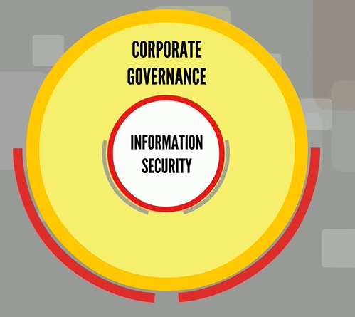
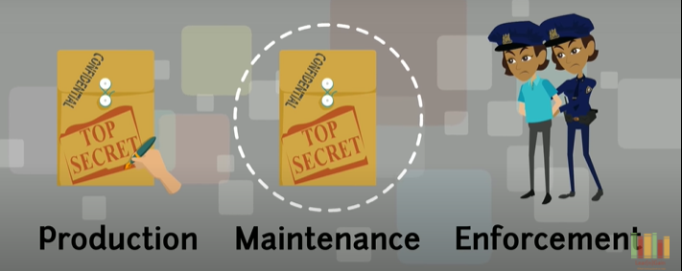
ITSM : Strategic Security Process
Introduction
Security Systems need to protect Operating systems, applications, databases, networks, and desktops.
There are dedicated security processes that pertain to each of these entities, the need is to develop an overall process which governs the integration and compatibility of these specialized systems.
Typically this would involve
Notes:
Designing security controls: To design suitable organizational and technical measures to guarantee the availability, integrity and confidentiality of an organization's data, information and IT services
Security testing: To ensure that all security mechanisms are subjected to regular testing
Managing security incidents: To identify and fight intrusions and attacks and also to minimize damages incurred due to security breaches
Security review: To review whether the safety measures and processes are still in accordance with risk perceptions from the business side, and also to validate whether these safety measures and processes are consistently managed and tested
The ITIL terms and information objects that are widely used in the security management process in order to signify process inputs and outputs are as follows
Availability/IT service continuity management (ITSCM)/security testing schedule
Correlation rules and event filtering
Information security policy
Information security report
Security management information system (SMIS)
Test report
Underpinning Information security policy
Security advisories
Security alert

Slide 6

ITSM : Strategic Security Process
Introduction
Notes:
Designing security controls: To design suitable organizational and technical measures to guarantee the availability, integrity and confidentiality of an organization's data, information and IT services
Security testing: To ensure that all security mechanisms are subjected to regular testing
Managing security incidents: To identify and fight intrusions and attacks and also to minimize damages incurred due to security breaches
Security review: To review whether the safety measures and processes are still in accordance with risk perceptions from the business side, and also to validate whether these safety measures and processes are consistently managed and tested
The ITIL terms and information objects that are widely used in the security management process in order to signify process inputs and outputs are as follows
Availability/IT service continuity management (ITSCM)/security testing schedule
Correlation rules and event filtering
Information security policy
Information security report
Security management information system (SMIS)
Test report
Underpinning Information security policy
Security advisories
Security alert

Slide 7
ITSM : Strategic Security Process
Introduction
This is intended to set up security controls to identify threats, remediate and manage risks while safeguarding the availability, integrity, and confidentiality of Data say through
Security testing: To ensure that all security mechanisms are subjected to regular testing
Managing security incidents: To identify and fight intrusions and attacks and also to minimize damages incurred due to security breaches
Security review: To review whether the safety measures and processes are still in accordance with risk perceptions from the business side, and also to validate whether these safety measures and processes are consistently managed and tested
Security in use of extranets & intranets is also a corporate Governance requirement
ITIL would look at the
Availability/IT service continuity management (ITSCM)/security testing schedule
Correlation rules and event filtering
Information security policy
Information security report
Security management information system (SMIS)
Test report
Security advisories
Security alert
Notes:
Designing security controls: To design suitable organizational and technical measures to guarantee the availability, integrity and confidentiality of an organization's data, information and IT services
Security testing: To ensure that all security mechanisms are subjected to regular testing
Managing security incidents: To identify and fight intrusions and attacks and also to minimize damages incurred due to security breaches
Security review: To review whether the safety measures and processes are still in accordance with risk perceptions from the business side, and also to validate whether these safety measures and processes are consistently managed and tested
The ITIL terms and information objects that are widely used in the security management process in order to signify process inputs and outputs are as follows
Availability/IT service continuity management (ITSCM)/security testing schedule
Correlation rules and event filtering
Information security policy
Information security report
Security management information system (SMIS)
Test report
Underpinning Information security policy
Security advisories
Security alert

Slide 8
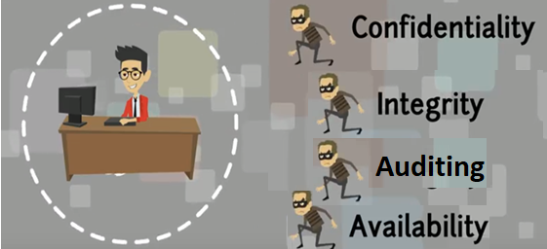
ITSM : Strategic Security Process
Introduction
Def: Strategic security Process is a process designed to safeguard the availability, integrity, and confidentiality of designated data & programs against unauthorized access, modification, or destruction
Data and programs : Corporate assets including DB and meta Data to be protected like patents, trademarks and competitive advantages
Availability : Appropriate individuals can access data and programs, from whatever means necessary or them to conduct their company’s business
Integrity : Data and programs have the same content and format as what was originally intended.
Confidentiality : Sensitive data is accessed only by individuals properly authorized.
Notes:
Designing security controls: To design suitable organizational and technical measures to guarantee the availability, integrity and confidentiality of an organization's data, information and IT services
Security testing: To ensure that all security mechanisms are subjected to regular testing
Managing security incidents: To identify and fight intrusions and attacks and also to minimize damages incurred due to security breaches
Security review: To review whether the safety measures and processes are still in accordance with risk perceptions from the business side, and also to validate whether these safety measures and processes are consistently managed and tested
The ITIL terms and information objects that are widely used in the security management process in order to signify process inputs and outputs are as follows
Availability/IT service continuity management (ITSCM)/security testing schedule
Correlation rules and event filtering
Information security policy
Information security report
Security management information system (SMIS)
Test report
Underpinning Information security policy
Security advisories
Security alert

Slide 9
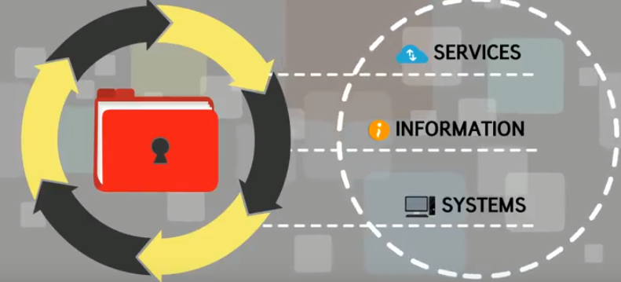
ITSM : Strategic Security Process
Developing a Strategic Security Process
Developing a Strategic Security program leads to designing a strategic security process from which strategic security policies are developed, approved, implemented, maintained and enforced. This would involve the following 12 steps involved with developing a strategic security process.
Initially this would lead to (1) Identifying an executive Sponsor (2) Selecting a process owner.
Then understanding the current and Existing Business and Information Security requirements for building the future security policies to support Confidentiality, Integrity and Availability. This would involve (3) Defining goals of strategic security. (4) Establishing review boards. (5) Identify, categorize, and prioritize requirements. (6) Inventorying the current state of security. (7) Establishing security organization.
Then building a set of controls as procedures and policies for managing the risks associated with services information and systems (8) Developing security policies.
Then executing the plans in terms of (9) Assembling planning teams. (10) Review and approval of plans. (11) Evaluating technical feasibility of plans. (12) Assigning and scheduling the implementation of plans.

Slide 10
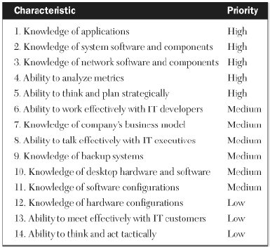
ITSM : Strategic Security
Developing a Strategic Security Process - 1
These 12 steps involved with developing a strategic security process are detailed as under
Identifying an executive Sponsor
This individual will champion and support the strategic security program by providing management direction and serves on the executive security review board
He will have the responsibility of selecting the security process owner.
Selecting a process owner.
Selected by the executive sponsor, will manage the day-to-day activities of the process.
Assembles and facilitates the cross-functional team that will brainstorm requirements
Since he would participate on the technical security review board that develops standards and implementation plans for various security policies, he should have the security mindset
Other than the knowledge of the systems, and having a strategic outlook, will also have keen insight into the analysis of security metrics

Slide 11
ITSM : Strategic Security
Developing a Strategic Security Process - 2
Defining Goals of Strategic Security
Executives should define and prioritize the specific goals of strategic security, scope in terms of which groups are included or is it enterprise wide,
This would be with consideration of availability, integrity, and confidentiality of data
Establishing Review Boards
The assessment and approval of security initiatives work best through a process consisting of two separately chartered review boards
Executive-level review board chartered with providing direction, goals, and policies concerning enterprise-wide security issues
Technical review board comprising of senior analysts and specialists who are qualified to evaluate the technical feasibility of security policies and initiatives proposed by the executive board; this board also sets enforceable security standards and procedures

Slide 12
ITSM : Strategic Security
Developing a Strategic Security Process - 3
Establishing Review Boards (contd.) Illustration of a Security Procedure
This second review board may also be chartered to help the implementation of the initiatives

Slide 13
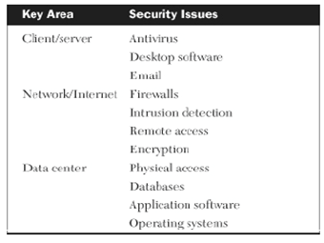
ITSM : Strategic Security
Developing a Strategic Security Process - 4
Identifying, Categorizing, and Prioritizing Requirements
Representatives from each of the two review boards, along with other appropriate subject-matter experts, need to meet to
Identify security requirements
Categorize them according to key areas for security issues
Prioritize them
Inventorying Current State of Security
Inventory of all current security-related items is taken to determine what’s already in-house and what may need to be developed or purchased. These could include:
Security policies approved, adhered to, and enforced
Security policies approved not in practice, drafted but not approved
Existing Software & Hardware security tools with the ability to be used for enforcement
Current security metrics available to analyze: Virus attacks, Password resets, Multiple sign-on’s, Trouble tickets

Slide 14
ITSM : Strategic Security
Developing a Strategic Security Process - 5
Establishing Security Organization
Establish a centralized security organization, to be headed by a security manager, with responsibilities and authorities jointly determined by the two security review boards and other appropriate areas of management.
This would factor in the list of requirements, the inventory of current security policies, tools, and metrics and would be positioned as determined by the review boards
Developing Security Policies
This starts with eliminating the obsolete and ineffective policies, modifying those requiring changes and development of new policies.

Slide 15
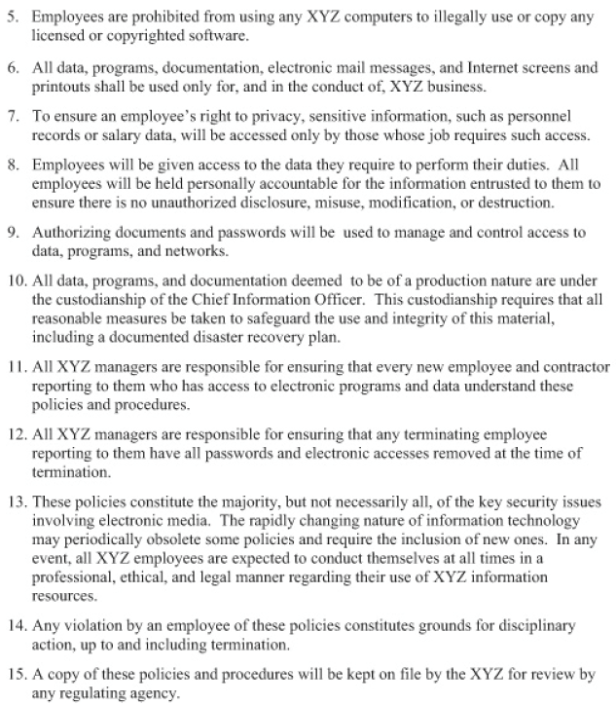
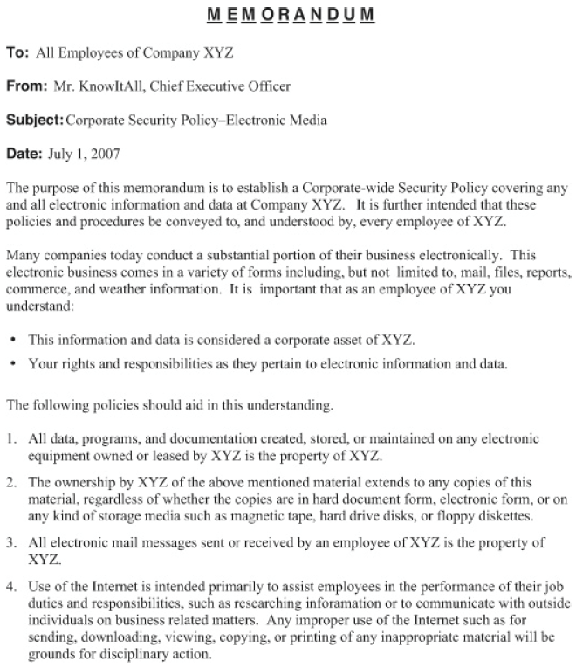
ITSM : Strategic Security
Developing a Strategic Security Process - 6
Developing Security Policies (Contd.)

Slide 16
ITSM : Strategic Security
Developing a Strategic Security Process - 7
Assembling Planning Teams
Cross-functional teams should be assembled to develop implementation plans for new policies, procedures, initiatives, and tools proposed by the either of the two security review boards.
Reviewing and Approving Plans
Executive security review board should review the implementation plans from a standpoint of policy, budget, schedule, and priority.
Evaluating Technical Feasibility of Plans
The technical security review board should evaluate the implementation plans from a standpoint of technical feasibility and adherence to standards
Assigning the plans to teams and Scheduling for Implementation
Individuals or teams should be assigned responsibilities and schedules for executing the implementation plans and also for maintenance of the policies
Notes:
Plan, Implement, Evaluate and Maintain for controlling the Security

Slide 17
ITSM : Strategic Security
Assessing an Infrastructure’s Strategic Security Process
The worksheet presents a quick-and-simple method for assessing the overall quality, efficiency, and effectiveness of a Strategic security process

Slide 18
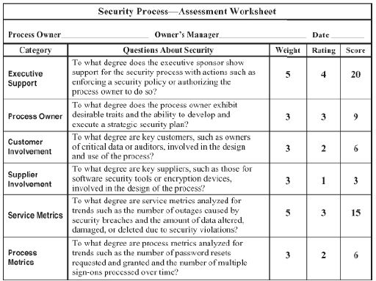
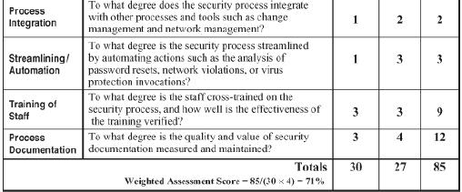
ITSM : Strategic Security
Assessing an Infrastructure’s Strategic Security Process
If we need to tailor this for a specific organization, then with weightages

Slide 19
ITSM : Strategic Security
Measuring and Streamlining the Strategic Security Process
We can measure and streamline the security process with the help of the assessment worksheet.
We can measure the effectiveness of a security process with service metrics such as the number of outages caused by security breaches and the amount of data altered, damaged, or deleted due to security violations.
We can also look at the Process metrics such as the number of password resets requested and granted and the number of multiple sign-ons processed over time, help us gauge the efficiency of this process.
We can streamline the security process by automating certain actions, for example, the analysis of password resets, network violations, or virus protection invocations.

Slide 20
Business Continuity

Slide 21
ITSM : Business Continuity
Introduction
IT infrastructure disasters can happen in case of
Natural disasters such as earthquakes, floods or tornados
Man-created scenarios and the cascading effects of those scenarios
Localized events, such as broken water pipes, fires, or gas leaks etc. which can cause disruptions.
Survey by the Business Continuity institute indicates that atleast 20% of organizations have disruptions of different levels every year
Disaster Planning is necessary for
Organization to continue to have Business Value
Protection of Assets
Legal liability and Compliance
Keeping up with the Public Image
Employee and Customer Safety
Prevention of Fraud
Avoid Loss of revenue
Customer Satisfaction and avoiding loss of customers
Lost productivity
Employee Satisfaction and Retention
Notes:
9/11 ..frauds within an organization ..Arthur Anderson .. Dr Rajkumar ..
18 months majority of them 580 of them closed down
Business Continuity Institute .. 20% suffer disruptions every year ..
Suppliers .. And chain .. Can be disrupted …
Holistic management process that identifies potential threats for the organization which impacts Business operations .. Or disables org capability to provide uninterrupted services to customers .. Provides a framework organizational resilience .. Anticipating disruption and managing at and beyond
Reputation
Contractual
Procurement qualifier

Slide 22
ITSM : Business Continuity
Introduction
93% of firms that lose their Datacenter for 10 days go bankrupt within a year
Research indicates 40-60% of organizations which did not have a good disaster recovery plan close down after a disaster. E.g. 9/11 580 closed down within 18 months of a disaster
Only 6% of organizations without a DR and BC plans will survive long term
Challenges from a Disaster Recovery and Business Continuity
Business Landscape is change
Many companies are in Market Places where infrastructure is not stable
Distributed business functions are distributed in the World
IT environment is changing Cloud Computing, Mobility and Outsourcing
Challenge to recover .. But all of these are distributed .. Creating a Gap between what IT can do and what the Business expects from Business functionality
Notes:
9/11 ..frauds within an organization ..Arthur Anderson .. Dr Rajkumar ..
18 months majority of them 580 of them closed down
Business Continuity Institute .. 20% suffer disruptions every year ..
Suppliers .. And chain .. Can be disrupted …
Holistic management process that identifies potential threats for the organization which impacts Business operations .. Or disables org capability to provide uninterrupted services to customers .. Provides a framework organizational resilience .. Anticipating disruption and managing at and beyond
Reputation
Contractual
Procurement qualifier

Slide 23
ITSM : Business Continuity
Introduction
Best Practices for Business Continuity
Corporate will need to look at it as a program .. Leadership sponsorship (PMO)
Business Continuity and Disaster Recovery will need to work codependently
Recovery objective based on Business process rather than Technology level
Communication (Stake Holder interviews with Business leaders)
Analyze the Business targets and expectations around targets
Practice and Practice
Notes:
9/11 ..frauds within an organization ..Arthur Anderson .. Dr Rajkumar ..
18 months majority of them 580 of them closed down
Business Continuity Institute .. 20% suffer disruptions every year ..
Suppliers .. And chain .. Can be disrupted …
Holistic management process that identifies potential threats for the organization which impacts Business operations .. Or disables org capability to provide uninterrupted services to customers .. Provides a framework organizational resilience .. Anticipating disruption and managing at and beyond
Reputation
Contractual
Procurement qualifier

Slide 24
ITSM : Business Continuity
Introduction
Def: Business continuity is a methodology to ensure the continuous operation of critical business systems in the event of widespread or localized disasters to an infrastructure environment. Continuous operation of critical business systems- Act of staying in Business in- spite of disasters
This could be looked at as an optimized insurance and like all insurance is difficult to quantify and prove ROI.
Business Continuity is necessary for IT governance, in terms of corporate governance, regulatory requirements (Accountability and securing information) and supply chain assurance and competitive advantage
Business continuity as a management discipline will include identification of the disasters (as a risk), contingency planning (mitigation for the risk) for the Business to get back functionally or for Business recovery and plans for getting back to a fully functional state till the Disaster recovery can happen.
People will need to know how to manage and use the Business continuity plan which would mitigate and respond to the incidence/risk
Resources used as part of the Business continuity plan will need to be reliable and proven for contingency
Reliable and proven communication mechanisms should be established and valuated for the purpose
Summarily business continuity is a methodology involving planning, preparation, testing, and continual updating for Business resumption during a Disaster

Slide 25
ITSM : Business Continuity
Introduction
Contrasting Disaster Recovery plans and Business Continuity plans
Disaster Recovery plan outlines how a company
Prepares for Disaster
Reacts to Disaster
Recovers from Disaster
Will expect the roles to be assigned rehearsed and revised
Minimize the long term impact to the company
Disaster planning is beyond Backups
Typically is the focus of the service providers
Business Continuity plans deals with how to deal with the consequences of these disasters, or what steps the organization has to take to minimizing the adverse impact and to minimize interruption for the continuity of critical business processes from either a localized or a wide-spread disaster.
Its focused towards supporting a set of prioritized critical business processes which are the focus of the Businesses/Key customers
Minimize the short term business impact to the company
SaaS/IaaS are some technologies for supporting the same
Typically both are led by IT but needs involvement of other departments

Slide 26
ITSM : Business Continuity
Case Study – Movie Studio
IT infrastructure of a Movie Studio consisting of IBM AS/400 midrange processors, when being updated to IBM AS/400 9406-level machines, had a external distribution transformer explosion due to a short-circuit.
This IT infrastructure hosted applications involved in the scheduling of broadcast times for programs and commercials for the company’s new premier cable television channel, and application managing the production, distribution, and accounting of US domestic entertainment videos, laser discs, and interactive games, which became unavailable for around six days due to a disaster.
IT Infrastructure had no formal recovery plan in place, because of which IT personnel, suppliers, and customers all scurried to minimize the impact of the outage, and had to thrash to move to a location 40 miles away. The studio’s AS/400 operating systems, application software, and databases were all restored and critical functionality was made operational but took ~24 hours of downtime and thrashing. (Business Resumption)
It took an additional 6 days to support the complete needs of the AS/400 customers which happened after replacing the failed transformer. (Disaster Recovery)
Lessons Learnt :
Conceptually there is a difference between Disaster recovery and that of Business resumption.
Disasters can be small, localized incidents, such as broken water pipes/Electrical equipment failures.
Firm commitment from executive management is needed to have a formal business continuity plan (Insurance) since it needs hardware, software, budget, and the time and efforts of knowledgeable personnel
Focus of Key customers will be on Business Resumption where as for suppliers it will be Disaster Recovery
Notes:
Recovery time objective – Business resumption .. – Minimal functionality ..

Slide 27
ITSM : Business Continuity
Steps to Developing an Effective Business Continuity Process
Acquire Executive Support
Select a Process Owner
Assemble a Cross-Functional Team
Conduct a Business Impact Analysis
Identify and Prioritize Requirements
Assess Possible Business Continuity Recovery Strategies
Develop a Request for Proposal (RFP) for Outside Services
Evaluate Proposals and Select the Best Offering
Choose Participants and Clarify Their Roles on the Recovery Team
Document the Business Continuity Plan
Plan and Execute Regularly Scheduled Tests of the Plan
Conduct a Lessons-Learned Postmortem after Each Test
Continually Maintain, Update, and Improve the Plan

Slide 28
ITSM : Business Continuity
Steps to Developing an Effective Business Continuity Process - 1
Acquire Executive Support
There are many resources like hardware, software, budget, and the time and efforts of knowledgeable personnel, required to design and maintain an effective program. All of these need funding approval, which needs support from Executives.
In the eventuality of a disaster occurring, there are sequence of events involving management decisions about deploying the IT recovery team, declaring an emergency to the disaster recovery service provider, notifying facilities and physical security, and taking whatever emergency preparedness actions may be necessary. There will be a lot of emotional and financial buy-in which will need to be secured, and having an Executive supporting this will help in smooth execution of the Business continuity process even in case of an disaster.
Executive would select a process owner, help in acquiring support from the managers of the participants of the cross-functional team for choice of participants and to ensure that participants are properly chosen and committed to the program.
Executive sponsor also needs to demonstrate ongoing support by requesting and reviewing frequent progress reports, offering suggestions for improvement, questioning unclear elements of the plan, and resolving issues of conflict.

Slide 29
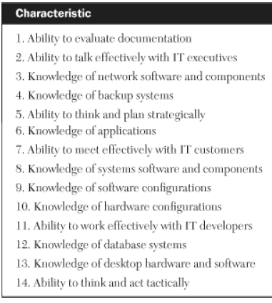
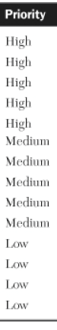
ITSM : Business Continuity
Steps to Developing an Effective Business Continuity Process - 2
Select a Process Owner
The process owner must assemble and lead the cross-functional team in such diverse activities as preparing the business impact analysis, identifying and prioritizing requirements, developing business continuity strategies, selecting an outside service provider, and conducting realistic tests of the process
This person should exhibit several key attributes which are typically found with operations supervisors, the data center managers, or even the infrastructure manager, like effective communication with executives, ability to critically review documentation, prioritizing their critical processes and applications
Knowledge of process like network systems backup systems can help

Slide 30
ITSM : Business Continuity
Steps to Developing an Effective Business Continuity Process - 3
Assemble a Cross-Functional Team
The Representatives of appropriate departments from several areas inside and outside of IT should be assembled into a cross-functional design team
This team works on requirements, conducts a business impact analysis, selects an outside service provider, designs the final overall recovery process, identifies members of the recovery team, conducts tests of the recovery process, and documents the plan
Computer operations
Applications development
Key customer departments
Facilities
Data security
Physical security
Network operations
Server and systems administration
Database administration

Slide 31
ITSM : Business Continuity
Steps to Developing an Effective Business Continuity Process - 4
Conduct a Business Impact Analysis (BIA)
Its not practical from a cost-expense perspective to include every Business process and Application as part of the recovery process, hence a prioritized inventory of critical business processes should be done for selection and inclusion to the recovery process.
The Business processes and Application can be categorized as say priority A, B and C based on the requirement of the process/Application to be started up within 24,72 and beyond without significant Business impact like financial impact(loss of revenue) or impact to operations and hence the customers
Summarily this step would look at
Disruption Risks
Impact of Business process disruption
Resources for Business Resumption and Recovery

Slide 32
ITSM : Business Continuity
Steps to Developing an Effective Business Continuity Process - 5
Identify and Prioritize Requirements
Brainstorming by the cross functional team to identity requirements for the process, such as business, technical, and logistical requirements
Business requirements include defining the specific criteria for declaring a disaster and determining which processes are to be recovered and in what time frames. (This is the trigger for the risk of disaster)
Technical requirements include what type of platforms will be eligible as recovery devices for servers, disk, and desktops and how much bandwidth will be needed.
Logistical requirements include the amount of time allowed to declare a disaster as well as transportation arrangements at both the disaster site and the recovery site.

Slide 33
ITSM : Business Continuity
Steps to Developing an Effective Business Continuity Process - 6
Assess Possible Business Continuity Recovery Strategies
Business continuity recovery strategies are based on the Business impact analysis and the list of prioritized requirements from the cross-functional team.
These alternative business continuity recovery strategies could be like alternative remote sites within the company, and geographic hot sites supplied by an outside provider.
This could be considered as assessing contingency plans for the risk
Develop a Request for Proposal (RFP) for Outside Services
If the scope of the IT shop is significant and the requirements involving business continuity warrant outside services, the cross-functional team develops an RFP, which is a proposal for an outside provider to supply disaster recovery services.
Options should include multiple-year pricing, guaranteed minimum amount of time to become operational, costs of testing, provisions for local networking, and types of onsite support provided.
Criteria should be weighted to facilitate the evaluation process.

Slide 34
ITSM : Business Continuity
Steps to Developing an Effective Business Continuity Process - 7
Evaluate Proposals and Select the Best Offering
The weighted criteria previously established are used to evaluate the RFP responses
Visit to the bidder’s facilities, testimonials from customers should be part of the evaluation process and decision to be made with criteria including costs and Overall Benefit
Choose Participants and Clarify Their Roles on the Recovery Team
A recovery team needs to be formed with participants similar to the cross functional team designing the process (but different from the design team) and additional representatives from service providers (if the plan includes them) and Key customer representatives as determined by BIA and Executive sponsor.
Each of the recovery teams individual’s role and responsibility is clearly defined, documented and communicated
Document the Business Continuity Plan
The cross-functional design team will need to document the business continuity plan for use by the recovery team, which will take the responsibility for maintaining the accuracy, accessibility and distribution of the plan.
Documentation of the plan must also include up-to-date configuration diagrams of the hardware, software, and network components involved in the recovery.

Slide 35
ITSM : Business Continuity
Steps to Developing an Effective Business Continuity Process - 8
Plan and Execute Regularly Scheduled Tests of the Plan
Business continuity test plans will need to be for ~3 years with every 6 months the tests becoming progressively more involved. This testing would use a checklist and test results with the duration of the planned & actual tasks being captured.
The tests would start with program and data restores, followed by processing loads and print tests, then initial network connectivity tests, and eventually full network and desktop load and functionality tests.
Dry runs are done where a recovery situation is created and executed to flush out minor snags and communication gaps that could prevent an otherwise flawless recovery
Conduct a Lessons-Learned Postmortem after Each Test
A retrospective of how the tests got executed, what went well, what needs to be improved
Continually Maintain, Update, and Improve the Plan
An infrastructure environment is ever-changing with New applications, expanded databases, additional network links, and upgraded server platforms etc. which unless updated will make the disaster recovery plans to be inaccurate, incomplete, or obsolete
The recovery team also will have changes in personnel affecting training, documentation, and even budgeting for tests which needs to be factored into the plans

Slide 36
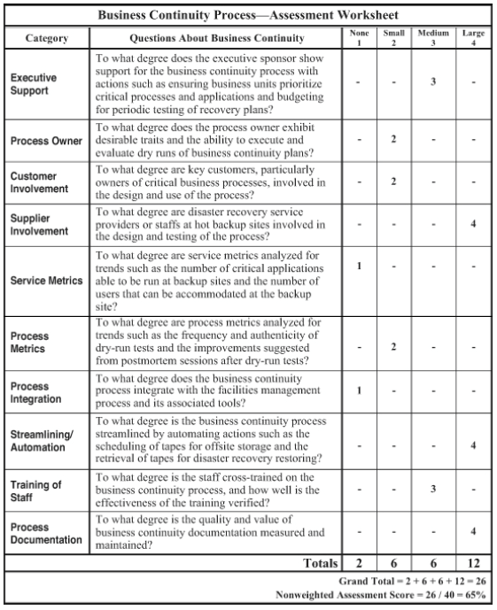
ITSM : Business Continuity
Assessing an Infrastructure’s Business Continuity Process
The worksheet presents a quick-and-simple method for assessing the overall quality, efficiency, and effectiveness of a Business Continuity process

Slide 37
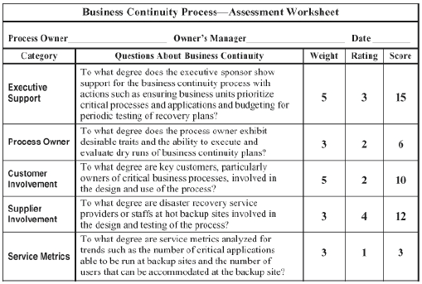
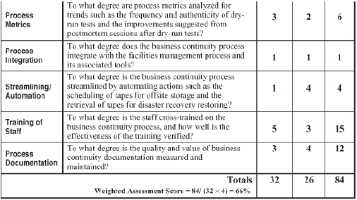
ITSM : Business Continuity
Assessing an Infrastructure’s Business Continuity Process
If we need to tailor this for a specific organization, then with weightages

Slide 38
ITSM : Business Continuity
Measuring and Streamlining the Business Continuity Process
We can measure and streamline the Business Continuity process with the help of the assessment worksheet.
We can measure the effectiveness of a business continuity process with service metrics such as the number of critical applications that can be run at backup sites and the number of users that can be accommodated at the backup site
We can use the Process metrics such as the frequency and authenticity of dry-run tests and the improvements suggested from postmortem sessions after dry-run tests, which help us gauge the efficiency of this process
We can streamline the disaster recovery process by automating actions such as the scheduling of tapes for offsite storage and the retrieval of tapes for disaster recovery restorations.

Slide 39
Discussions

